Slide 1
Greater New Jersey Postal Customer Council
Spring Meeting
June 10, 2014

Slide 2
Agenda
Full-Service Verification
eInduction
Seamless

Slide 3
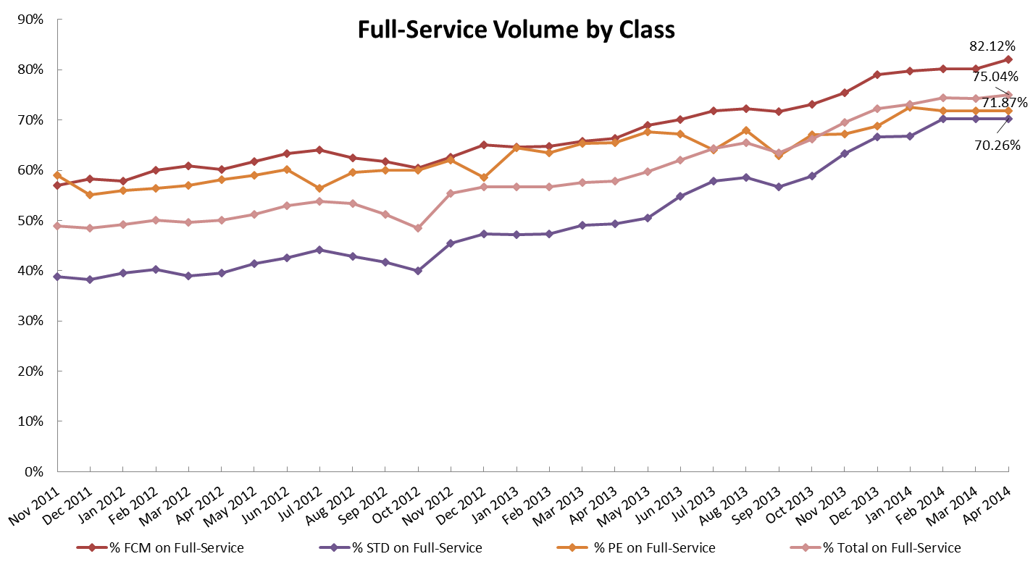
Full Service:Status
75% of total volume is Full-Service
Working to 100% adoption
Active Mailer Contact
Promoting Software vendors with certified solutions

Slide 4
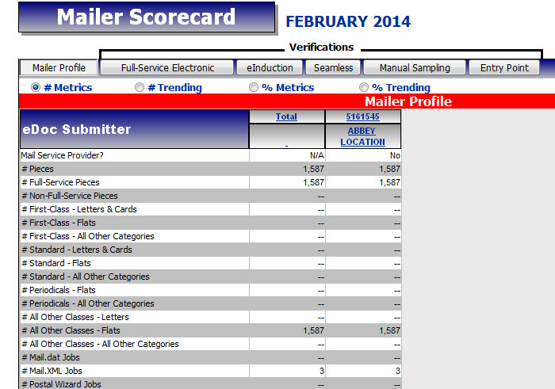
eDoc: Full-Service Electronic Verification
Full-Service Electronic Verification is a system-driven check of the mailer’s electronic mailing documentation against Full-Service preparation rules
No assessments until Jan. 2015
Additional Postage displayed in Oct. using Sept. Data
All verifications are performed only looking at values provided in the eDoc
Results available within 48 hours of processing the mailing

Slide 5
Full-Service: Current Compliance Metrics
Full Service Electronic Verification Approach
Full Service Verifications | Thresholds | April Percentages
Service Type ID | 2% | 99.95%
Mailer ID | 2% | 99.87%
Unique Piece Barcode (IMb) | 2% | 97.99%
Unique Tray Barcode (IMtb) | 2% | 99.66%
Unique Container Barcode (IMcb) | 2% | 99.29%
By/For | 5% | 89.25%
Co-Palletization (.OCI) | 5% | 96.76%
Entry Facility | 5% | 99.95%
5

Slide 6
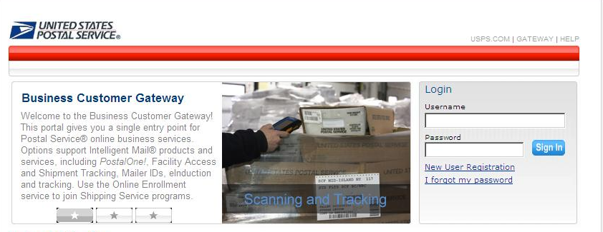
Mailer Scorecard: How to Access
Enter the appropriate user name and password in the Business Customer Gateway
Select Sign In
Notes:
How do I get to my reports?

Slide 7
Mailer Scorecard: How to Access
Scroll down to the Tools & Wizard section
Select Mailing Reports
Notes:
How do I get to my reports?

Slide 8
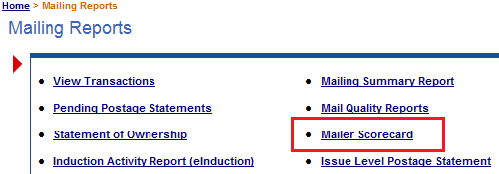
Mailer Scorecard: How to Access
Select Mailer Scorecard
Notes:
How do I get to my reports?

Slide 9
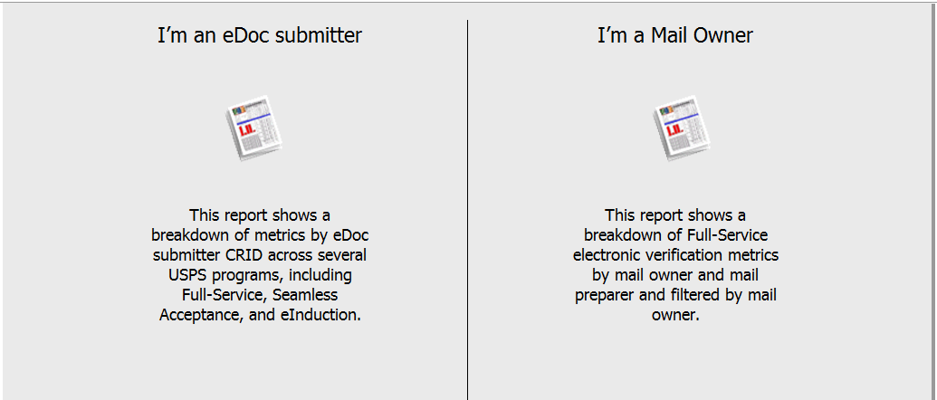
Mailer Scorecard: How to Access
Reports can be run as the eDoc submitter or Mail Owner

Slide 10
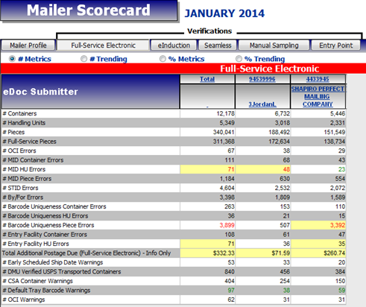
Mailer Scorecard
Summarizes Full-Service performance
Compare across facilities
Available for eDoc Submitters, preparers and owners
Manage mailing quality
View errors in detail

Slide 11
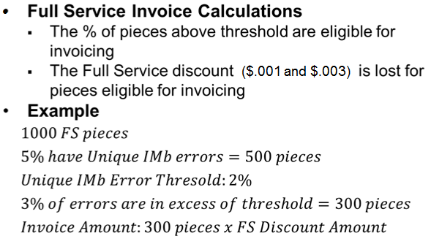
Full Service Invoicing

Slide 12
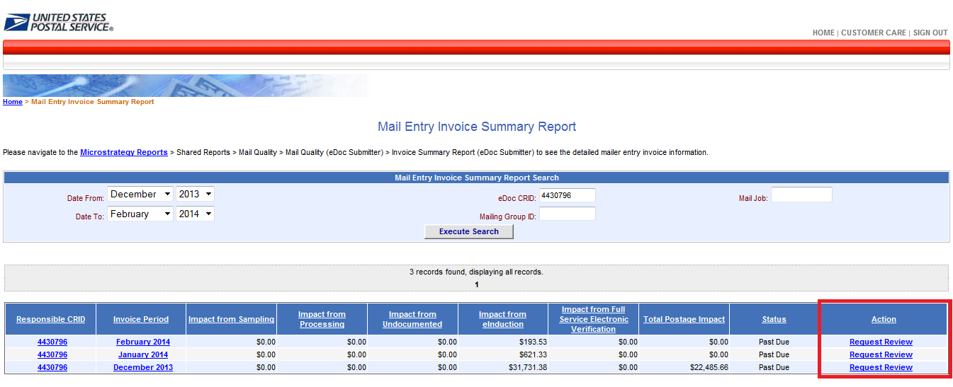
Full Service Invoicing
Full Service Invoice Reports-Invoice Summary

Slide 13
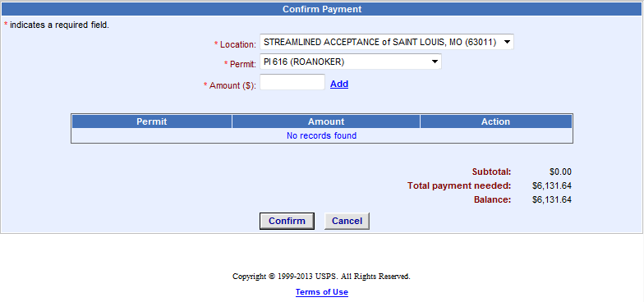
Full Service Invoicing
Full Service Invoice Reports-Invoice Payment
Invoice amounts can be allocated across all permits associated to the invoiced CRID

Slide 14
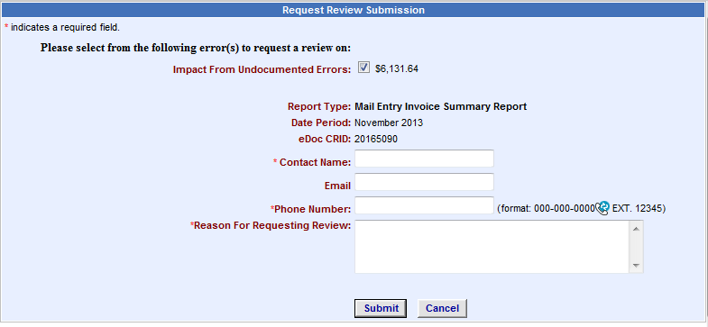
Full Service Invoicing
Full Service Invoice Reports-Invoice Review Request
Mailers can request a review of an invoice by BMS

Slide 15
MOVE Update
Full-Service
Free ACS for residual pieces from Full-Service mailings
Eliminate Move Update Assessments per mailing and transition to a trend approach limiting assessment to pieces in error for Full-Service mailings
Discussions being held in WG 143

Slide 16
Streamlines Drop-shipments and Expedited plant loads
What is eInduction?
eInduction will result in quicker appointment processing, reduce errors, and improve revenue protection
Paper 8125/8107 | eInduction
Paper forms required for all shipments Entire shipment is held until resolved Appointment issues are resolved by calling origin site (if open) Entry discounts and induction location validated manually | No paper forms required for drop shipment Containers resolved individually 24/7 appointment resolution via NCSC Automated validation of entry discounts

Slide 17
eInduction Benefits
Streamlined process at induction
Time lost due to inaccurate or lost paperwork eliminated
Data based reconciliation
Electronic Container Information
Earlier recovery from errors
FAST Help Desk – 24/7 coverage
Reduced administration costs
No paper to track/keep
Simplified process at origin
Fewer acceptance processes
Reduced window from production to trailer

Slide 18
eInduction: Status
ACCESS MAIL | MAILINGS UNLIMITED
AMERICAN MAIL & INSERT | MEREDITH WEBB PRINTING
AUTOMATED PRESORT INC | MOMENTUM MAILING SYSTEMS
CENTURY DIRECT | NATIONAL DATA SERVICES
CLEAR VISIONS, INC. | NETFLIX*
COLORFX | PB PRESORT SERVICES INC
CPC | PROGRESSIVE IMPRESSIONS INT L
DINGLEY PRESS | PUBLICATION PRINTERS CORPORATION
DIRECT MAIL SOLUTIONS | QUAD GRAPHICS
DIRECT MAIL SYSTEMS | RR DONNELLEY*
DIRECT RESPONSE MARKETING | SOURCELINK GREENVILLE
DISABLED AMERICAN VETERANS | SUNCRAFT TECHNOLOGIES
DX MARKETING | TC DELIVERS
ENGAGE MARKETING | THE JOHN ROBERTS COMPANY
EU SERVICES | THE PRINTER INC
FAIRRINGTON TRANSPORTATION | TOWNE ADVERTISERS MAILING SERVICE
FGS | TRIBUNE PUBLISHING - NORTHLAKE CORP
FRANKLIN PRESS | TRI-WIN MAILING
HARTE HANKS | VALPAK DIRECT MARKETING SYSTEMS INC ST PETERSBURG
HUDSON PRINTING | VICTORY MAIL
IWCO DIRECT* | WATERMARK GROUP
J & A PRINTING INC HIAWATHA | WILEN DIRECT
JENCO PRODUCTIONS | WINDOW BOOK, INC.
JET MAIL SERVICES INC. | WORDTECH GROUP, THE
LITHOTONE | XPRESSDOCS
*: Limited sites/products
Over 27% of mailer shipment volume is eInduction
50 mailers submitting eInduction Mailings

Slide 19
eInduction: Scan Rate Trend

Slide 20
Outstanding eInduction Gaps
Gap | Status
Non SV Solutions | Expand to 10 Sites (~85% volume) Non SV Solution in Oct. 2014
Shipping Summary Report | Major improvements in August 2014
Mailer Scorecard | Improvements in August 2014
eInduction Invoicing | Fixes to defects in invoice calculations and underlying validations. Info-only invoice amounts will be correct in Jan 2015
Impact of Downstream Scans | Leverage all downstream scans for USPS process compliance
Mail.XML Status/Update Messages | Enhancements to performance, 3rd party access, and data returned scheduled for releases in, August, and October 2014

Slide 21
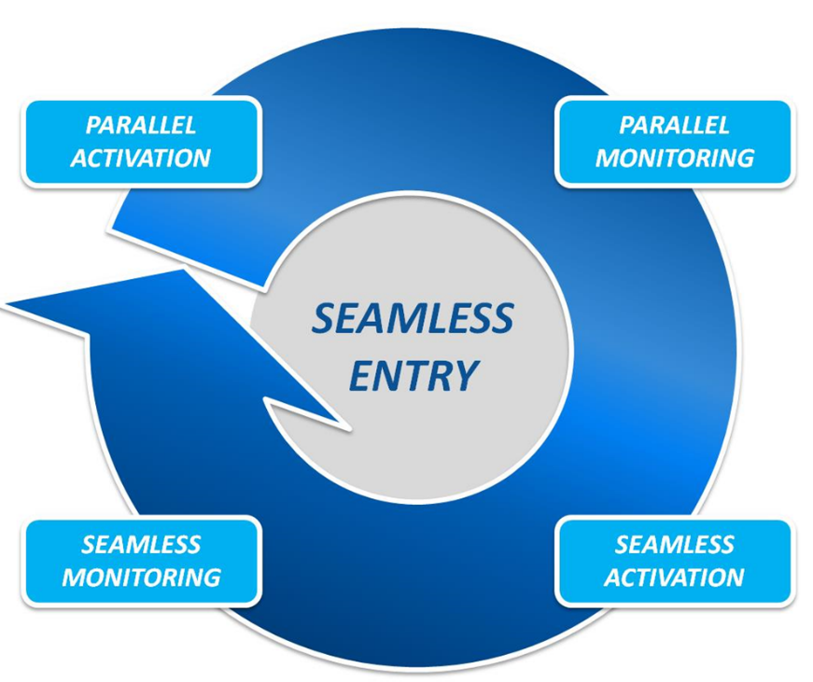
Seamless Overview
Barcodes and eDOC
Samples
Scans
Monthly Trends

Slide 22
Seamless Verifications
Verification | eDoc | Census | Sampling | Mailer Contact Threshold | Egregious Threshold
Undocumented |  | X | X | 0.5% | 0.8%
Delivery Point | X |  |  | 2% | 5%
Move/Update |  | X |  | 0.5% | 0.5%
Nesting/Sortation (MPE) |  | X |  | 1% | 3%
Nesting/Sortation (eDoc) | X |  |  | 2% | 4%
Nesting/Sortation (Sampling) |  |  | X | 3% | 5%
Mail Characteristic |  |  | X | 0.1% | 0.5%
Postage |  |  | X | 2% | 5%
Weight |  |  | X | 3% | 5%
Notes:
Seamless Acceptance = mailer locations that will be on Seamless Acceptance by 5/19
Approved Mailers = mailer locations that have qualified for Seamless Acceptance but will not be activated by 5/19
Parallel Mailers = mailer locations on Seamless Parallel that have not qualified for Seamless Acceptance
New Parallel Mailers = DMUs over 90% FS that aren’t currently on Seamless Acceptance

Slide 23
Seamless Status
Need your support in Migrating to Seamless
 | # Sites | # Pieces | % Total Volume
Seamless Acceptance | 21 | 297,663,342 | 2.73%
Approved Mailers | 58 | 874,709,085 | 8.02%
Parallel Mailers | 112 | 2,149,619,944 | 19.70%
New Parallel Mailers | 362 | 2,012,711,669 | 18.68%
Total | 553 | 5,334,704,040 | 49.13%
Notes:
Seamless Acceptance = mailer locations that will be on Seamless Acceptance by 5/19
Approved Mailers = mailer locations that have qualified for Seamless Acceptance but will not be activated by 5/19
Parallel Mailers = mailer locations on Seamless Parallel that have not qualified for Seamless Acceptance
New Parallel Mailers = DMUs over 90% FS that aren’t currently on Seamless Acceptance

Slide 24
Seamless Onboarding to Seamless
Seamless Parallel allows Mailers/USPS to fix Issues with Data
Begin to review Seamless results on the Mailer Scorecard
Evaluate results against thresholds
Work with USPS to identify the root causes on issues
Resolve any mail preparation issues identified in Parallel
After one month below threshold, mailers move to Seamless
Demonstrate mail quality under thresholds for at least one calendar month
Activate Seamless Acceptance

Slide 25
Seamless Benefits
Longer mail production cycle
Greater Flexibility in Mail Preparation
Permit Imprint Minimums removed
Bundle-Based Trays for MLOCR
Postage Payment Flexibility
Improved feedback and Trend based measurement
Auto-finalization
Verification Consistency
No More MERLIN

Slide 26
Thank You

